Slide 1

RECOMMENDATION ENGINE FOR ELECTRONICS
Naveena Ganapathi

Slide 2
SYNOPSIS
Challenge
Building a recommendation engine for 50 unique electronic brands based on user ratings
Issues
Each product is rated by some set of users but the number of users rated for each product differs which is a challenge to be considered while building a recommendation engine.
Background
We have a electronics dataset with item id, user id, rating, timestamp, model attribute, brand, year, user attribute, split. For our recommendation engine, we considered brand, rating and user id and finding correlation between the brands using user ratings

Slide 3
Problem Statement and Solution
Problem Statement
Building a recommendation engine for 50 unique electronic brands based on user ratings.
Dataset provided:
We have a electronics dataset with item id, user id, rating, timestamp, model attribute, brand, year, user attribute, split.
Consideration
For our recommendation engine, we considered brand, rating and user id and finding correlation between the brands using user ratings.
Solution
Finding a correlation between the brands using user ratings so that we can recommend products to the user based on similar purchase.

Slide 4
Technology Used Python Pandas

Slide 5
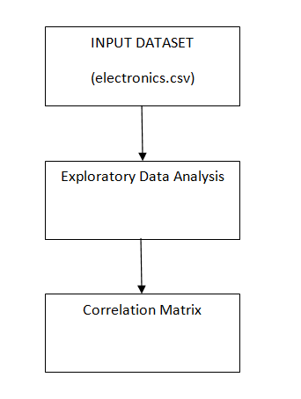
Solution Architecture

Slide 6
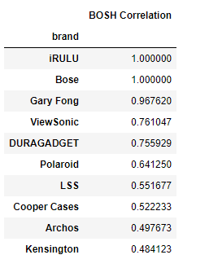
Prototype/ MVP Demo Video/Screenshots
Correlation between BOSH and other products

Slide 7
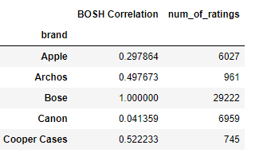
Challenges Faced
The solution is incorrect if we consider only average of ratings of a product, So number of users rated for a particular product should be taken into consideration on finding correlation.

Slide 8
Thank You
Notes:
Closing slide

